Slide 1
MODULE 2
Course Title: Electricity & Magnetism
Course Code: PHYS 102 Unit: 3 CU Lecturer: ABUBAKAR ABDULKADIR

Slide 2
Outline
Magnetic Field
Identify a Bar Magnet
Nature of field lines within a magnetic field using iron filings
Magnetic field lines around a bar magnet
Properties of Magnetic Field Lines
Lorentz Force
Dielectric Materials
Applications of dielectric materials

Slide 3
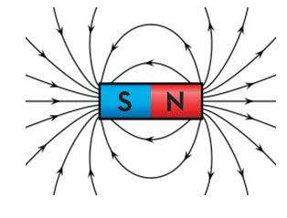
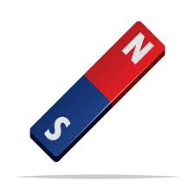
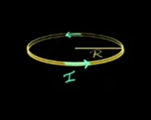
Magnetic Field
Concept of magnetic field
Magnetic Field lines
Imaginary lines used as a visual tool to represent magnetic fields.
They describe the direction of the magnetic force on a north monopole at any given position.
Definition of Magnetic field
A region around a magnetic material or a moving electric charge within which the force of magnetism acts is a Magnetic Field.
It has a unit of Tesla (T)
A magnet
A current loop

Slide 4
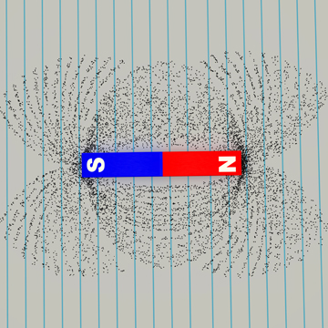
Nature of Magnetic Field Lines
Iron filings
Properties of Magnetic Field Lines
Magnetic field lines never cross each other
The density of the field lines indicates the strength of the field
Magnetic field lines always make closed loops
Magnetic field lines always emerge or start from the North Pole and terminate at the South Pole
A great way to see field lines within a magnetic field is to use iron filings.
Set a bar magnet down on a white paper .
sprinkle the filings onto the paper
watch as they form patterns of lines that are close together at one pole, more spread out as they leave that pole, and close together again at the magnet’s other pole. The filings are lining up along the bar magnet’s field lines

Slide 5


Lorentz Force
Concept in Electromagnetism Components of the force
Describes the force exerted on a charged particle, like an electron or proton, when it moves through the space containing electric field as well as the magnetic field.
The Lorentz force equation is given by;
$$\vec{F}=q(\vec{E}+\vec{V}×\vec{B})$$
$F$ the Lorentz force
$q$ charge of the particle
$E$Electric field
$V$ velocity of the particle
$B$ magnetic field
$×$ cross product
Electric force
$q\vec{E}$Due to the electric field, acting in the direction of the field.
Magnetic force
($q\vec{V}×\vec{B}$) acting perpendicular to both the velocity and magnetic field.

Slide 6
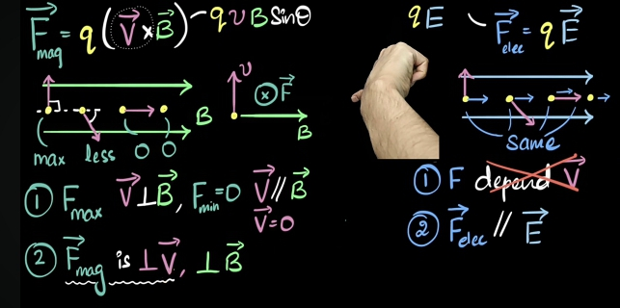
Cont…
Difference between the force due to magnetic field and the force due to the electric field

Slide 7
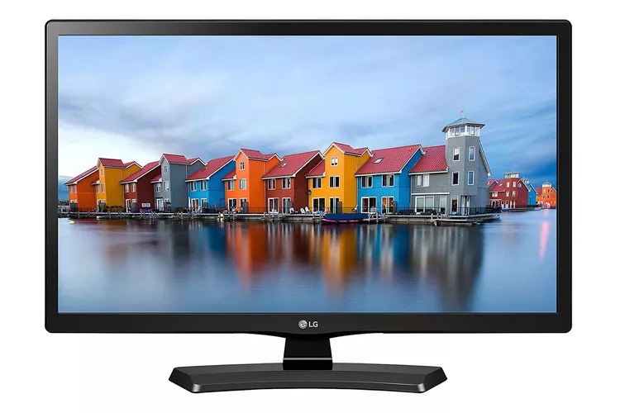
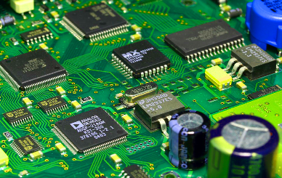

Dielectric Materials
Dielectrics are essential in the technologies we use every day for examples
They are present in industrial coatings to protect a surface (of metal, concrete, timber, glass, plastics, leather, mortar etc.) from damage like wear and tear, corrosion decay
They are also present in liquid crystal displays
They are used for energy storage in capacitors and to enhance devices based on semiconductors
They are present in cooling processes
In other word, modern society wouldn’t even exist without dielectric materials

Slide 8
Dielectric Materials
What are dielectric Materials?
Dielectrics, in general, can be described as
materials that are very poor conductors of electric current.
They are basically insulators and contain no free electrons.
Their behavior in an electric field is entirely different from that of conductors.
They are often called insulators because they are the exact opposite of conductors.
when insulators are called “dielectrics,” it’s because attention want to be drawn to a special property shared by all insulators: polarizability.
Dielectrics can be easily polarized when an electric field is applied to it.

